Slide 1
Loan-default Prediction using Machine Learning Presentation by Charles Apaw Institute of Data

Slide 2
Project analysis slide 3
Project Context
Objective:
In today’s competitive financial industry, managing risk is crucial for the survival and profitability of institutions. One of the significant risks that banks and other financial institutions face is the possibility of loan default. A loan default occurs when a borrower fails to make the required payments on their loan, which can lead to financial losses to the lender. To mitigate this risk, it is essential for financial institutions to be able to predict whether a borrower is likely to default before granting a loan. This prediction allows institutions to manage their resources more efficiently, reduce the chances of bad debts and make more informed lending decisions.
The focus of my project is to build a classification model that can predict whether a new borrower will default on a loan. This model will help financial institutions identify high-risk borrowers and take preventive measures, such as requiring additional collateral, offering higher interest rates to compensate for the risk, or even declining the loan application.
This kind of predictive modeling is not just about minimizing losses; it's also about enhancing the overall decision-making process. By using data-driven insights, institutions can tailor their loan offerings more effectively, thereby improving customer satisfaction and maximizing profitability.
Dataset:
For this project , I chose the loan default dataset from Kaggle. This dataset is comprehensive and includes a variety of features that are relevant to understanding a borrower’s likelihood of default. Some of these features include the borrower’s demographics such as age and income , financial data like credit score and debt-to-income ratio and specific loan details including loan amount and interest rate.
Loan Default Dataset (kaggle.com)

Slide 3
Project analysis slide 3
Exploratory Data Analysis(EDA)
Observations :
1 The mean interest rate is 4.045%, with a small standard deviation of 0.561%. The minimum interest rate is 0%, which could indicate an error or a special case, and the maximum is 8%. An interest rate of 0% is unusual and might represent a missing value or an error.
2 The interest rate spread ranges from -3.638 to 3.357, with a mean of 0.4417. The presence of negative values in the interest rate spread is unusual and this could easily be an error.
3 The income ranges from $0 to $578,580, with a mean income of $6,957.34. The presence of zero income suggests potential data issues or it could be a special case.
4 The loan amounts range from as low as $16,500 to as high as $3,576,500, with a mean of $331,117.70. The standard deviation is $183,909.30, indicating significant variation in loan sizes.
5 The Status column is a binary variable, with 24.64% of loans marked as defaults. This suggests the dataset is slightly imbalanced, with non-defaults being the majority.
6 The shape of the dataset was (148670, 34)
7 Checked for missing values and realised most of the columns had a lot of missing values

Slide 4
Feature Selection
One-Hot Encoding for Categorical Variables:
For Categorical features such as “Gender” , “Region” and “Loan_Purpose” , I used one-hot encoding to convert them into numerical features.
Also, I chose “Status” of the loan as my target variable because it categorises the loan into clear and interpretable outcomes such as “Paid” , “Defaulted” or “Written Off “ which aligns with our business problem.

Slide 5
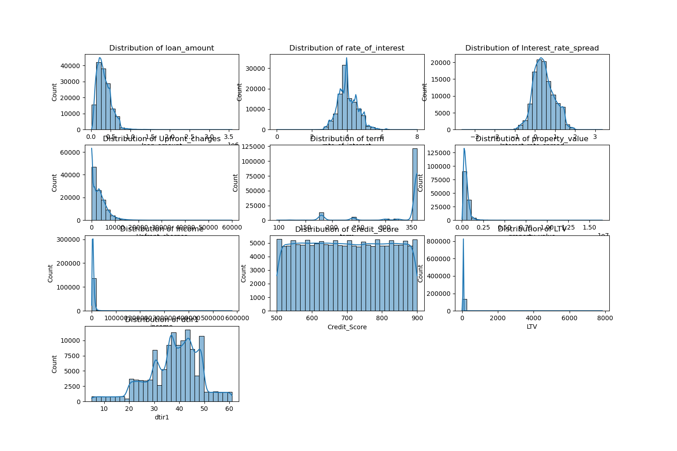
Histogram of Numerical values

Slide 6
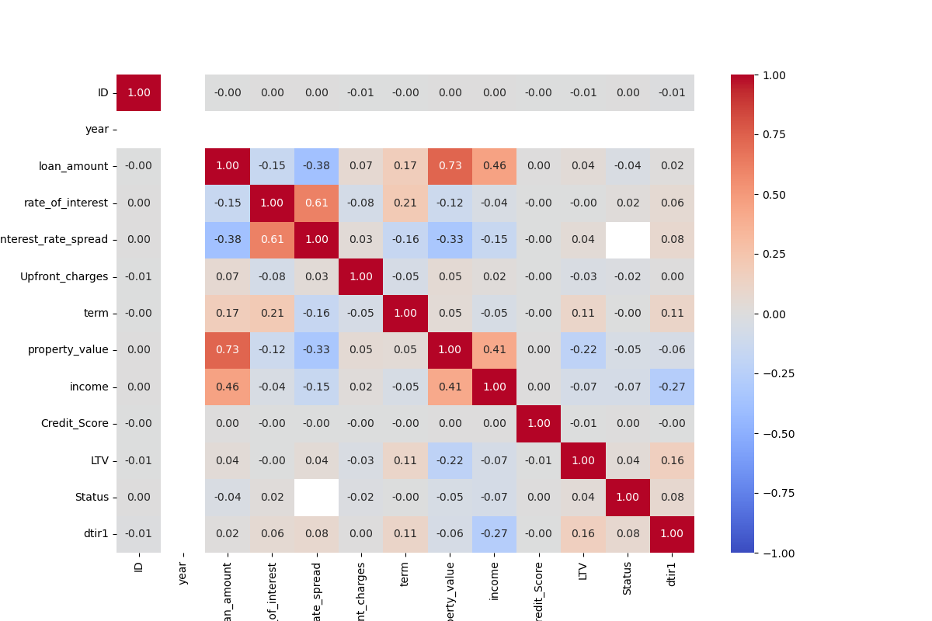
Correlation Heatmap

Slide 7
Modelling
It is important to note that before training the model , I had to use SMOTE to address the class imbalance because the data was highly imbalanced in favour of the Non-Default. Even went further to use SMOTE –Tomek which I found could help remove noisy examples close to the decision boundary.
. Random Forest:
Accuracy Score: 0.9999775789780498
Precision, Recall, F1-Score: All metrics are near perfect, indicating excellent model performance.
Confusion Matrix:
True Positives (TP): 10,913
True Negatives (TN): 33,687
False Positives (FP): 0
False Negatives (FN): 1
ROC-AUC Score: 1.0
Logistic Regression:
Accuracy Score : 0.8346225420954687
Confusion Matrix:
.True Positives(TP) : 7,687
.True Negatives(TN) : 29,538
.False Positives(FP) : 4,149
.False Negatives(FN) : 3,227
.ROC-AUC Score: 0.86427
Precision, Recall, F1-Score : High precision recall for both default and Non-Default
XGBoost:
.Accuracy Score: 0.999327
.Confusion Matrix :
.True Positives(TP) : 10,914
.True Negatives(TN) : 33,684
.False Positives(FP) :3
.False Negatives(FN) : 0
ROC-AUC Score : 0.9999856
Precision, Recall, F1-Score : All metrics are near perfect , similar to Random forest.

Slide 8
Recommendations
.Implement Risk-Based Pricing : Borrowers identified as higher risk could be offered loans at higher interest rates.
Enhance Credit Underwriting Process : Loans predicted to be high risk could undergo additional scrutiny or checks.
Develop targeted Intervention Strategies : For Borrowers identified as high risk, strategies such as financial counselling before and during loan term and also providing early notification.

Slide 9
Thank You

